Slide 1
Session 7. Hidden Intellectualism

Slide 2
I. Preliminary reading
Questions on content:
1. What are street smarts? Why do schools overlook the intellectual potential of street smarts?
2. According to the author, what should be done first if students want to be intellectual?
3. What does it mean by seeing interests through academic eyes?
(para. 1)
(para. 2)
What problem arises?
(para. 3)
(para. 4)
Why?
(para. 11,
12, and 13)
(para. 17)

Slide 3
1. What are street smarts? Why do schools and colleges overlook the intellectual potential of street smarts? What problem arises?
The phenomenon that students are intelligent about nonacademic things but unable to apply the intelligence to academic work. (para. 1)
We associate those street smarts with anti-intellectual concerns. (para. 2)
No necessary connection has ever been established between any text or subject (including those on street smarts) and the educational depth and weight of the discussion it can generate. (para. 3)

Slide 4
2. According to the author, what should be done first if students want to be intellectual?
Students should be encouraged to do so at first on subjects that interest them rather than ones that interest us.
(para. 4)
Why?
(para. 11, 12 and 13)
Contrast
Sports
Full of arguments and analysis (para. 11)
Satisfy the thirst for community (para. 12)
Real intellectual world organized like the world of team sports (para. 13)
Schools
Pale and unreal culture (para. 11)
Attract no public attention (para. 12)
Unable to use elements of drama and conflict that the intellectual world shares with sports (para. 15)

Slide 5
3. What does it mean by seeing interests through academic eyes?
Taking nonacademic interests as an object of academic study is not enough.
Students are required to think and write about their interests in a reflective, analytical way.
(para. 17)

Slide 6

II. Language points
(para. 7) I grew up torn, then … between the need not to jeopardize my respectable future and the need to impress the hoods.
The need not to jeopardize my respectable future
Study hard and make progress
The need to impress the hoods
The desire for the approval of the hoods

Slide 7
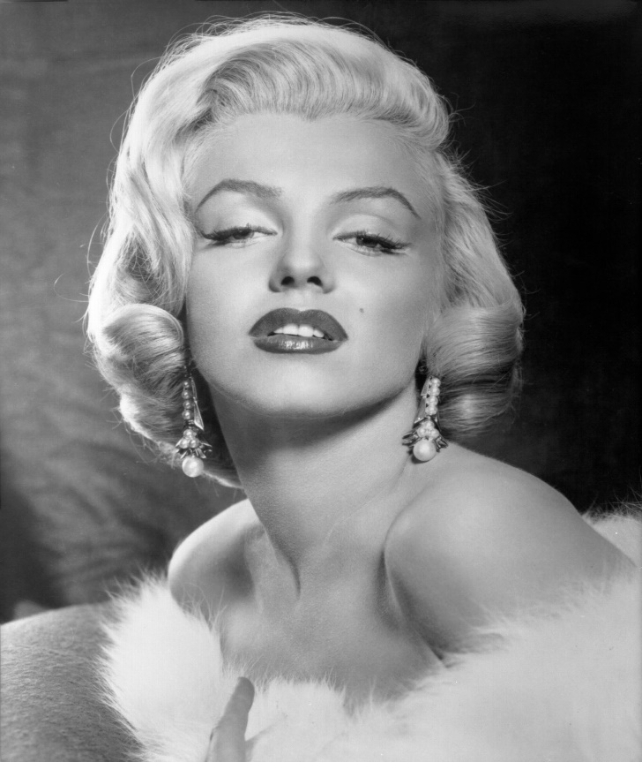
(para. 8) When Marilyn Monroe married the playwright Arthur Miller in 1956 after divorcing the retired baseball star Joe DiMaggio, the symbolic triumph of geek over jock suggested the way the wind was blowing.
Triumph
Winning Monroe’s heart
Geek over jock
The playwright (Miller) instead of the baseball star (DiMaggio)
The wind was blowing
People were not simply hostile toward intellectualism, but divided and ambivalent.
(rhyme)
(metaphor)

Slide 8
III. Appreciative Reading
Questions on content:
1. What are street smarts? Why do schools overlook the intellectual potential of street smarts?
2. According to the author, what should be done first if students want to be intellectual?
3. What does it mean by seeing interests through academic eyes?
(para. 1)
(para. 2)
What problem arises?
(para. 3)
(para. 4)
Why?
(para. 11,
12, and 13)
(para. 17)

Slide 9
Text Structure
(para. 1 - 3)
Introduction
Setting a scene:
Thesis statement
Any text or subject can generate educational depth and weight
Body
Taking nonacademic interests
Personal experience
Reasons
Seeing interests through academic eyes
Conclusion
street smarts & anti-intellectual concerns
(two suggestions)
(para. 4 - 17)
(para. 4 - 15)
(para. 5-10)
(exemplification)
(para. 11-15)
(causal analysis)
(contrast)
(para. 16 - 17)
(para. 18)

Slide 10
Can you find some abstract nouns in this text?
Intellectualism (title)
Legitimacy (para. 7)
Adolescence (para. 8)
Generalization (para. 10)
Counterargument (para. 10)
Methodologies (para. 13)
One-upmanship (para. 14)
…

Slide 11



祝你好运！
禁止吸烟！
小心滑倒！

Slide 12


你走错房间了！
Wrong room.

Slide 13
English: hypotactic（形合） Chinese: paratactic（意合）
雨是最寻常的，（它）一下就是三两天。（不过，你）可别恼，（你试着向外边）看，（它正在下着，）像花针，（也）像细丝，（它那么）密密地斜织着，（以至于）（人家的）屋顶上全笼着一层薄烟。
——朱自清《春》

Slide 14
English
Studies serve for delight, for ornament, and for ability. Their chief use for delight, is in privateness and retiring; for ornament, is in discourse; and for ability, is in the judgment and disposition of business. (On Studies by Francis Bacon)
Chinese
来的来，去的去。
Translation: Some come here, and others go away.
Tend to use nouns
Tend to use verbs

Slide 15
Nominalization
What is nominalization?
A process converting non-nouns in a sentence to nouns.

Slide 16
People lie.
Iron is strong.
He gazed at me tenderly.
They find it tedious, because they’re bad at it.
People’s lying
The strength of iron
The tenderness of his gaze
The reason why they find it tedious is that they’re bad at it.
action
quality
circumstance
logic
thing
verb adjective adverb conjunction noun

Slide 17
(para. 5) Until I entered college, I hated books and cared only for sports.
(para. 5) The only reading I cared to do or could do was sports magazines, …, becoming a regular reader …
I only cared to read sports magazine regularly?
(para. 5) I also loved the sports novels …
(para. 5) my preference for sports over schoolwork was not anti-intellectualism so much as intellectualism by other means
I was intellectual by other means when I preferred sports to schoolwork?
Before entering college
During my college years
Now

Slide 18

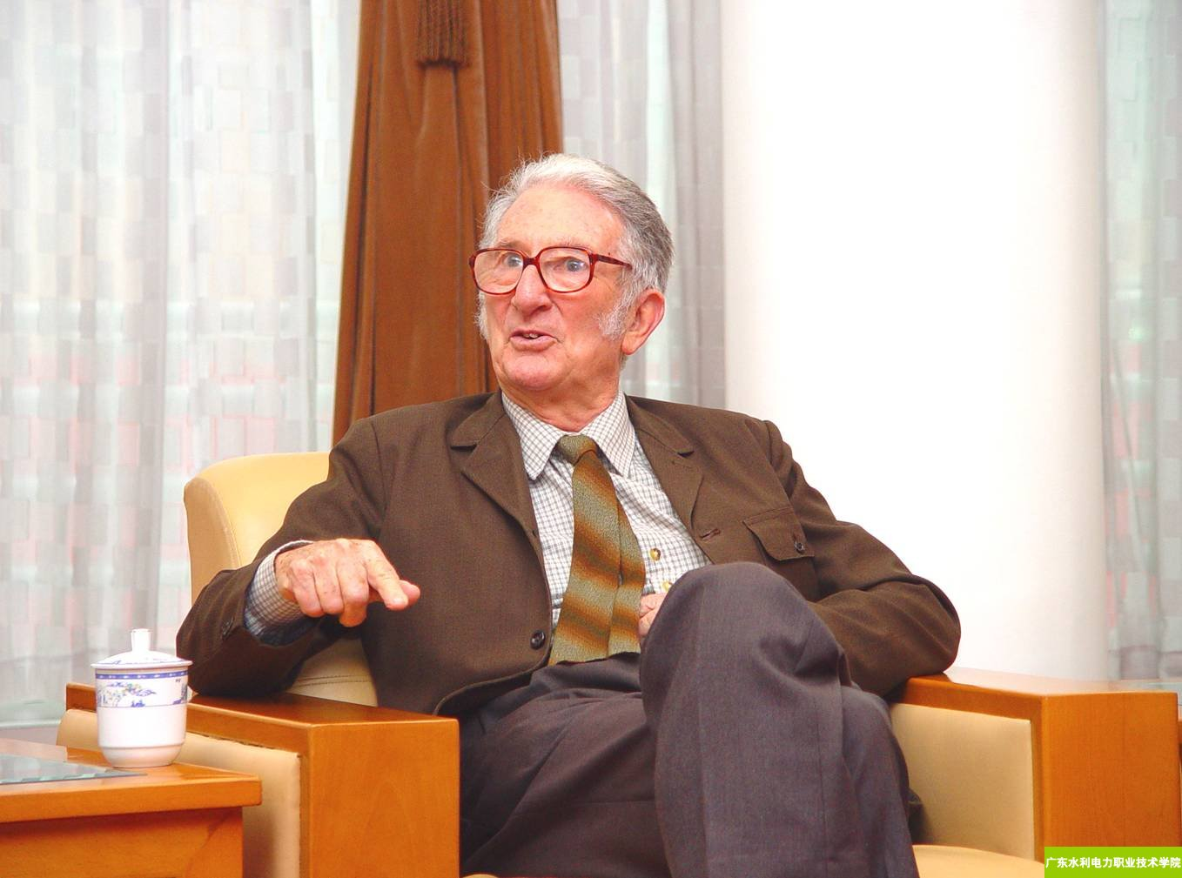
In English scientific writing
The origin of nominalization:
Treatise on the Astrolabe (Chaucer, c. 1390)
Opticks (Newton, 1704)
The discovery of nominalization
The unusual Refraction is therefore perform’d by an original property of the Rays. (Opticks, p. 358)
vs.

Slide 19
In English scientific writing
Nominalization
If we want to develop a model, we need to understand how stress accelerates the bond rupture reaction.
“The development of a…model…requires an understanding of how stress accelerates the bond rupture reaction.” (Scientific American)
The “favorite sentence pattern of English scientific writing” (Halliday, 2006)
Complex sentence -> simple sentence
Predicate verbs -> the subject and object nouns
Logic -> verbs

Slide 20
(conjunction)
-> verb
-> noun
(the 20th century)
Logic
If we want to develop a model, we need to understand how stress accelerates the bond rupture reaction.
“The development of a…model…requires an understanding of how stress accelerates the bond rupture reaction.” (Scientific American)
An understanding of how stress accelerates the bond rupture reaction is a pre-condition of the development of a model.

